Slide 1

Web Development & Design Foundations with H T M L 5
Ninth Edition
Chapter 8
Tables
Copyright © 2019, 2017, 2015 Pearson Education, Inc. All Rights Reserved
Notes:
If this PowerPoint presentation contains mathematical equations, you may need to check that your computer has the following installed:
1) MathType Plugin
2) Math Player (free versions available)
3) NVDA Reader (free versions available)

Slide 2
Learning Objectives
8.1 Create a basic table with the table, table row, table header, and table cell elements
8.2 Configure table sections with the thead, tbody, and tfoot elements
8.3 Increase the accessibility of a table
8.4 Style an H T M L table with C S S
8.5 Describe the purpose of C S S structural pseudo-classes

Slide 3
H T M L Table
Tables are used on web pages to organize tabular information
Composed of rows and columns – similar to a spreadsheet.
Each individual table cell is at the intersection of a specific row and column.
Configured with table, tr, and td elements

Slide 4
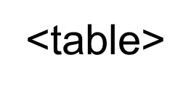
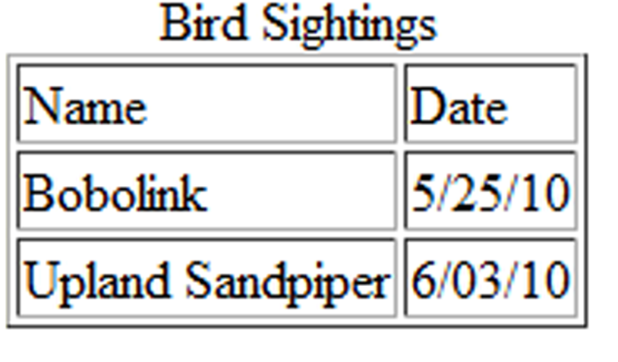

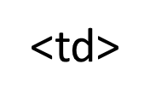
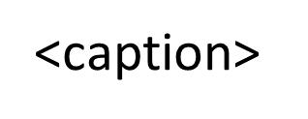
H T M L Table Elements
Contains the table
Contains the table row
Contains the table cell
Configures a description of the table

Slide 5
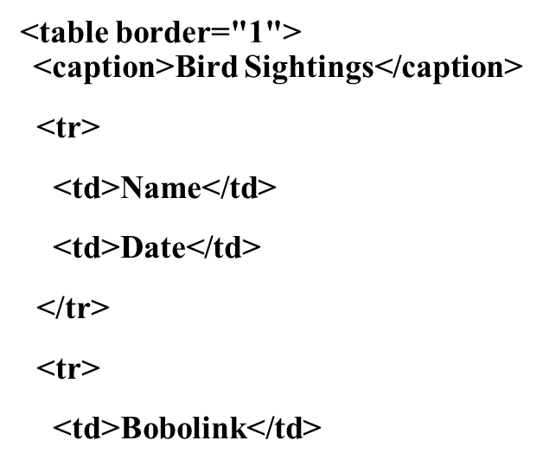
H T M L Table Example 1 (1 of 2)

Slide 6
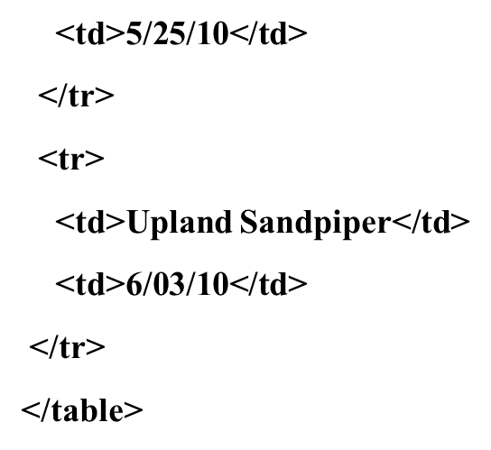
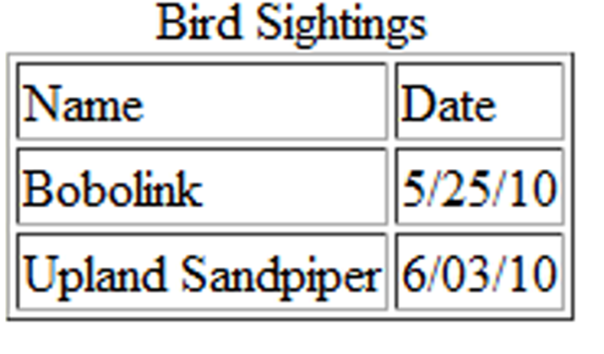
H T M L Table Example 1 (2 of 2)

Slide 7
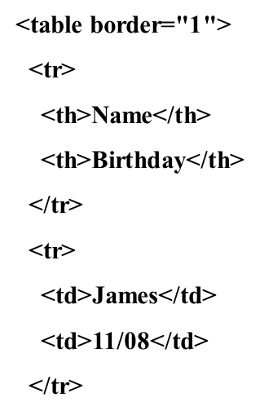
H T M L Table Example 2 (1 of 2)

Slide 8
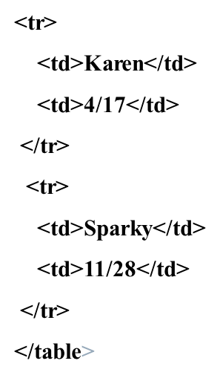
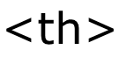
H T M L Table Example 2 (2 of 2)
Using the
Element

Slide 9
H T M L Table Attributes
align (obsolete)
bgcolor (obsolete)
border
cellpadding (obsolete)
cellspacing (obsolete)
summary (obsolete but may be reinstated)
width (obsolete)
Use C S S to configure table characteristics instead of H T M L attributes

Slide 10
H T M L Common Table Cell Attributes
align (obsolete)
bgcolor (obsolete)
colspan
rowspan
valign (obsolete)
height (deprecated)
width (deprecated)
Use C S S to configure most table cell characteristics instead of H T M L attributes

Slide 11
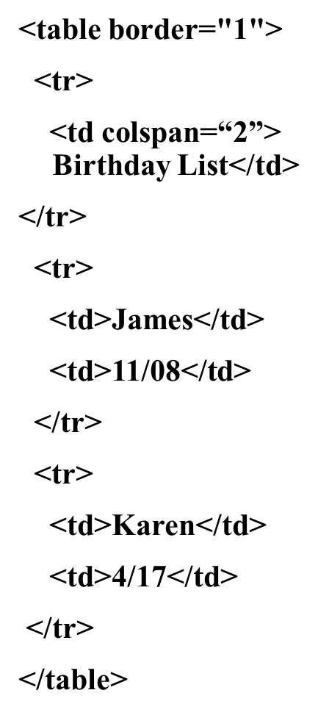
H T M L Colspan Attribute

Slide 12
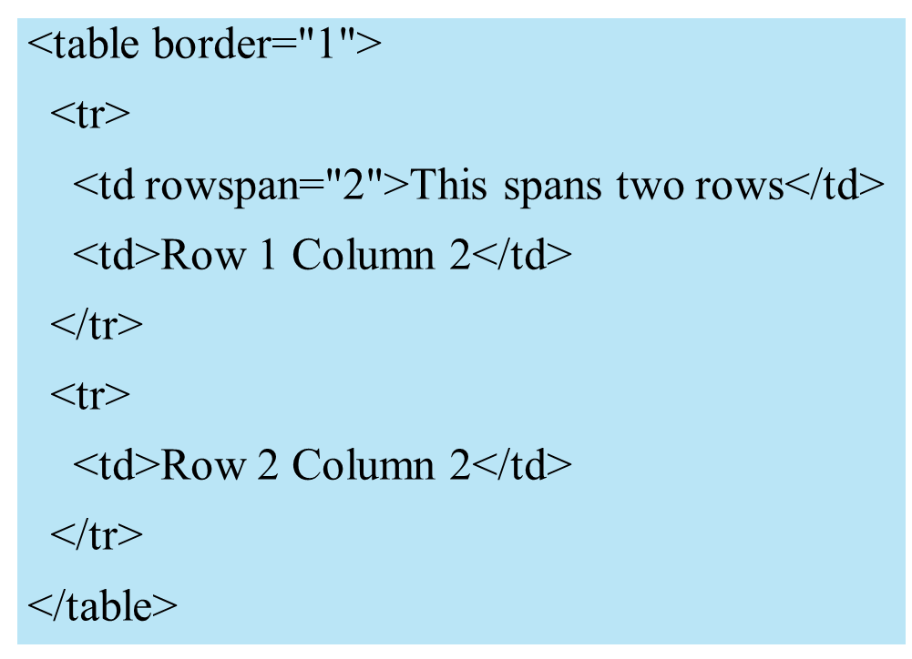
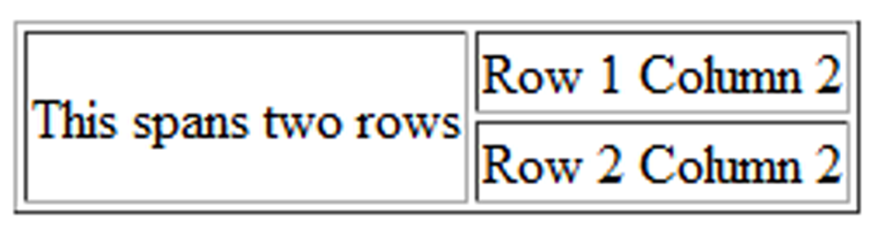
H T M L Rowspan Attribute

Slide 13
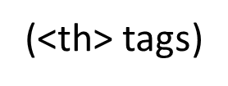
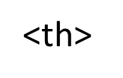
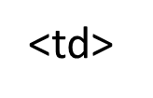
Accessibility and Tables
Use table header elements
to indicate column or row
headings.
Use the caption element to provide a text title or caption for the table.
Complex tables: Associate table cell values with their corresponding headers
tag id attribute
tag headers attribute

Slide 14
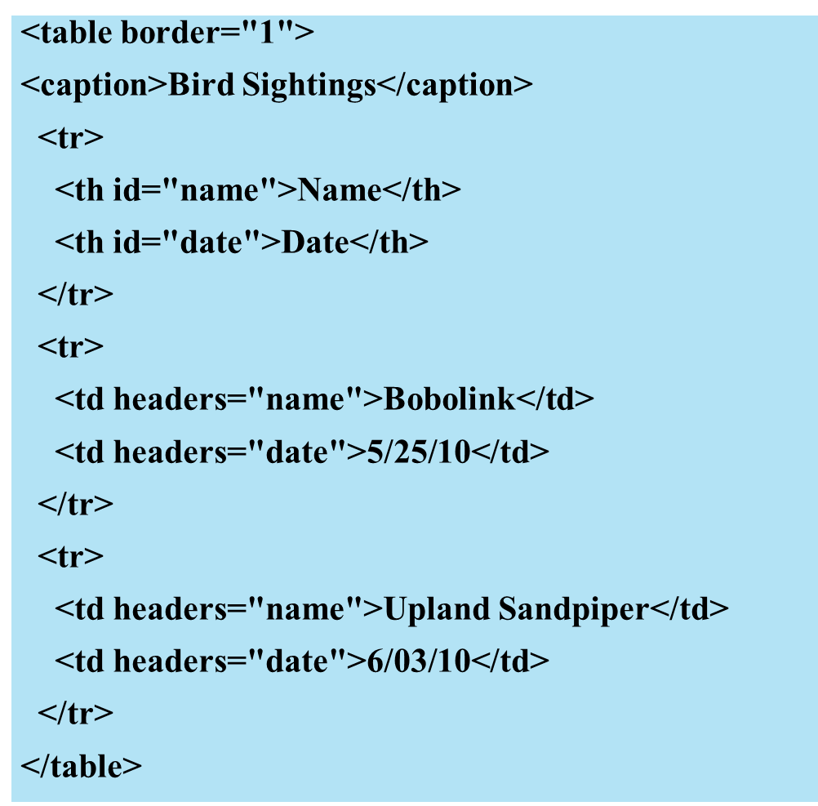
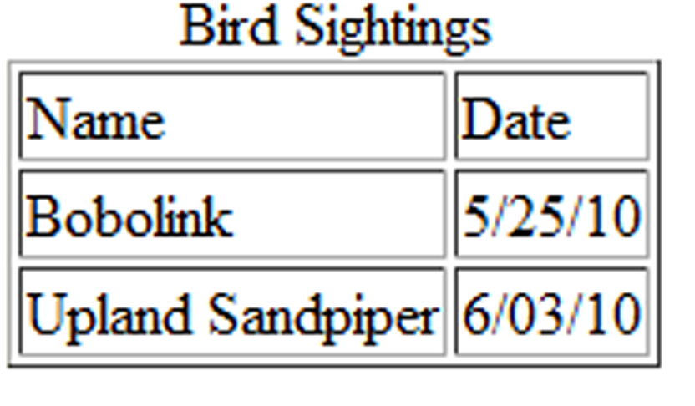
Table Captions

Slide 15
Checkpoint 8.1
Describe the purpose of using a table on a web page.
How is the text contained in a th element displayed by the browser?
Describe one coding technique that increases the accessibility of an H T M L table.

Slide 16
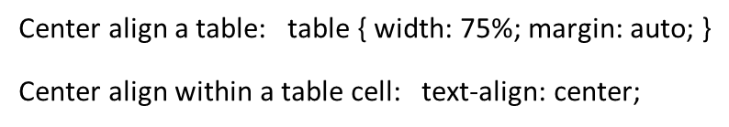
Using C S S to Style a Table
H T M L Attribute | C S S Property
Align | center align a table colon table left bracket space width colon 75% semi colon margin colon auto semi colon space right bracket. Center align within a table cell colon space text hyphen align colon center semi colon
Bgcolor | background-color
Cellpadding | Padding
Cellspacing | border-spacing or border-collapse
Height | Height
Valign | vertical-align
Width | Width
Border | border, border-style, or border-spacing
-- | background-image

Slide 17
C S S Structural Pseudo-Classes
Pseudo-class | Purpose
:first-of-type | Applies to the first element of the specified type
:first-child | Applies to the first child of an element (C S S2 selector)
:last-of-type | Applies to the last element of the specified type
:last-child | Applies to the last child of an element
:nth-of-type(n) | Applies to the “nth” element of the specified type Values: a number, odd, or even
Zebra Stripe a Table

Slide 18
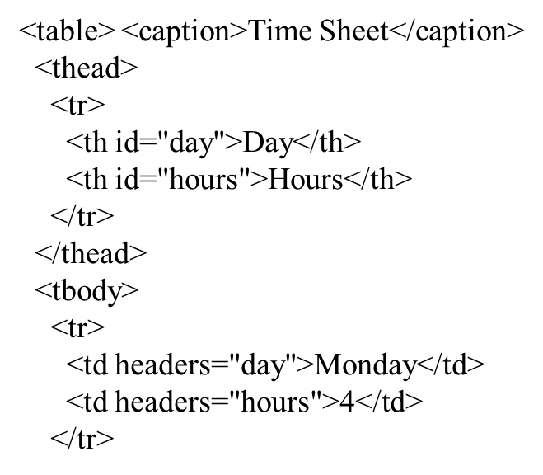
Table Row Groups (1 of 2)

Slide 19
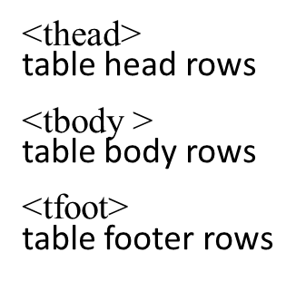
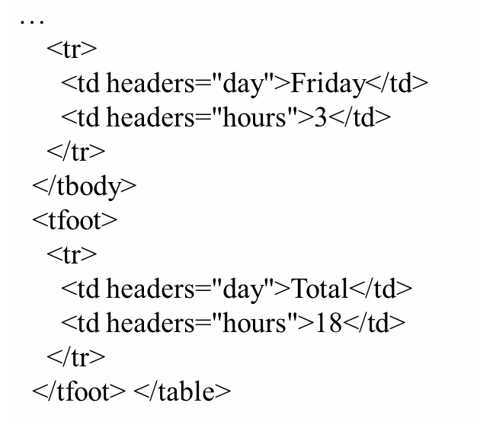
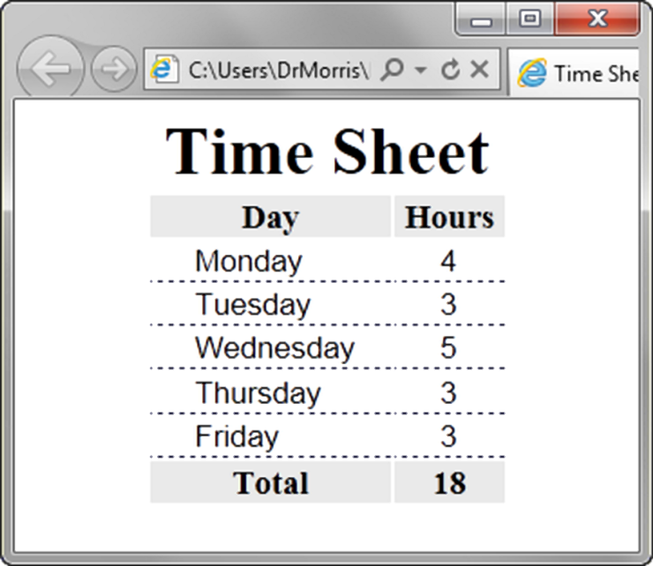
Table Row Groups (2 of 2)

Slide 20
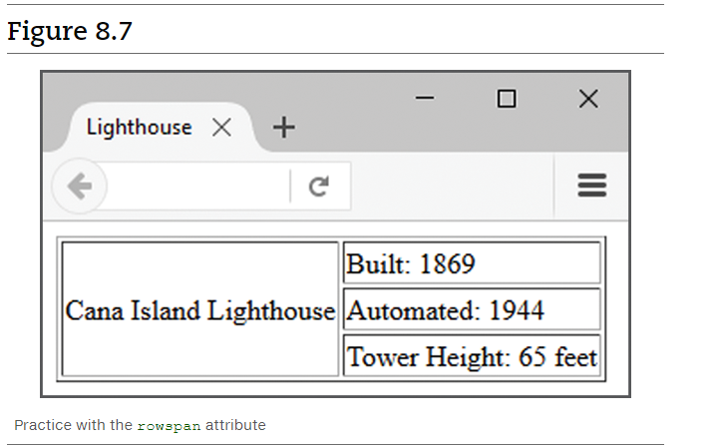
Exercise

Slide 21
Checkpoint 8.2
Describe a reason to configure a table with C S S properties instead of H T M L attributes.
List three elements that are used to group table rows.

Slide 22
Summary
This chapter introduced the H T M L and C S S techniques used to create and configure tables on web pages.

Slide 23

Copyright

